Slide 1
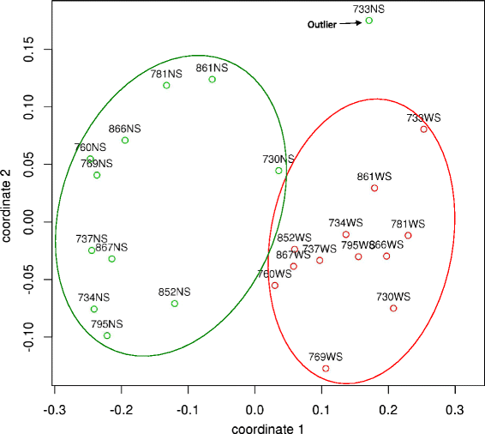
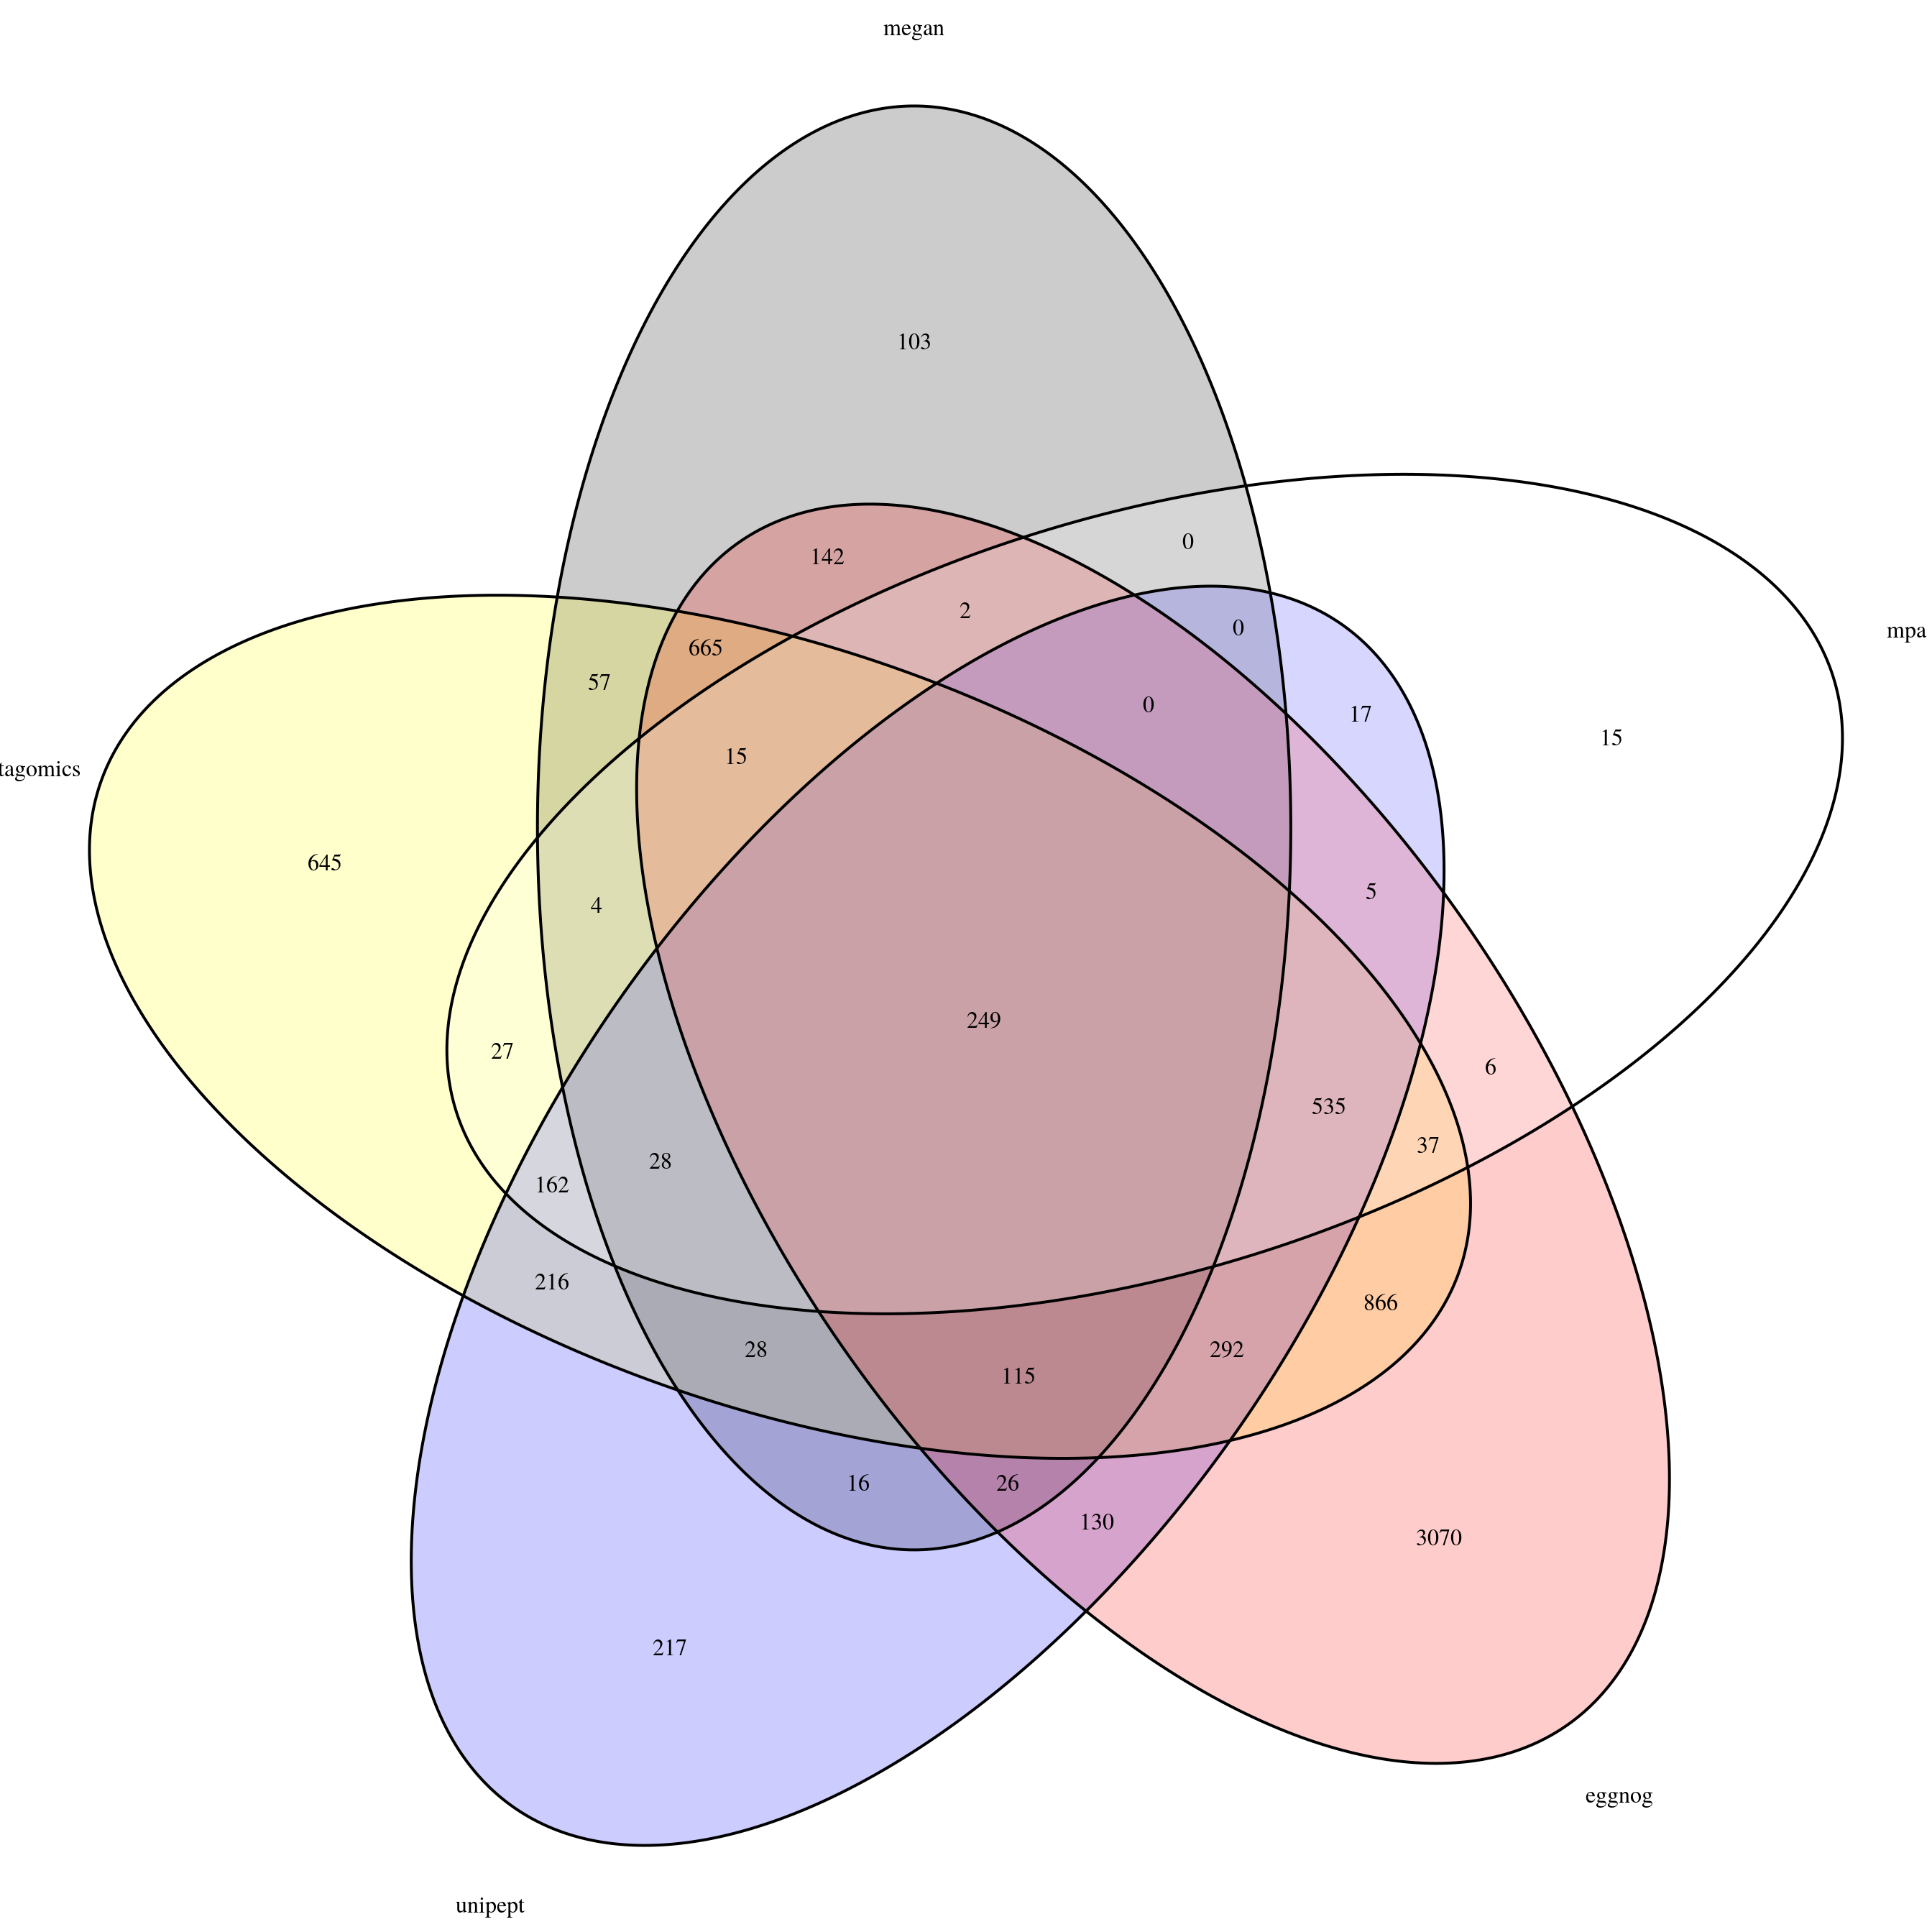
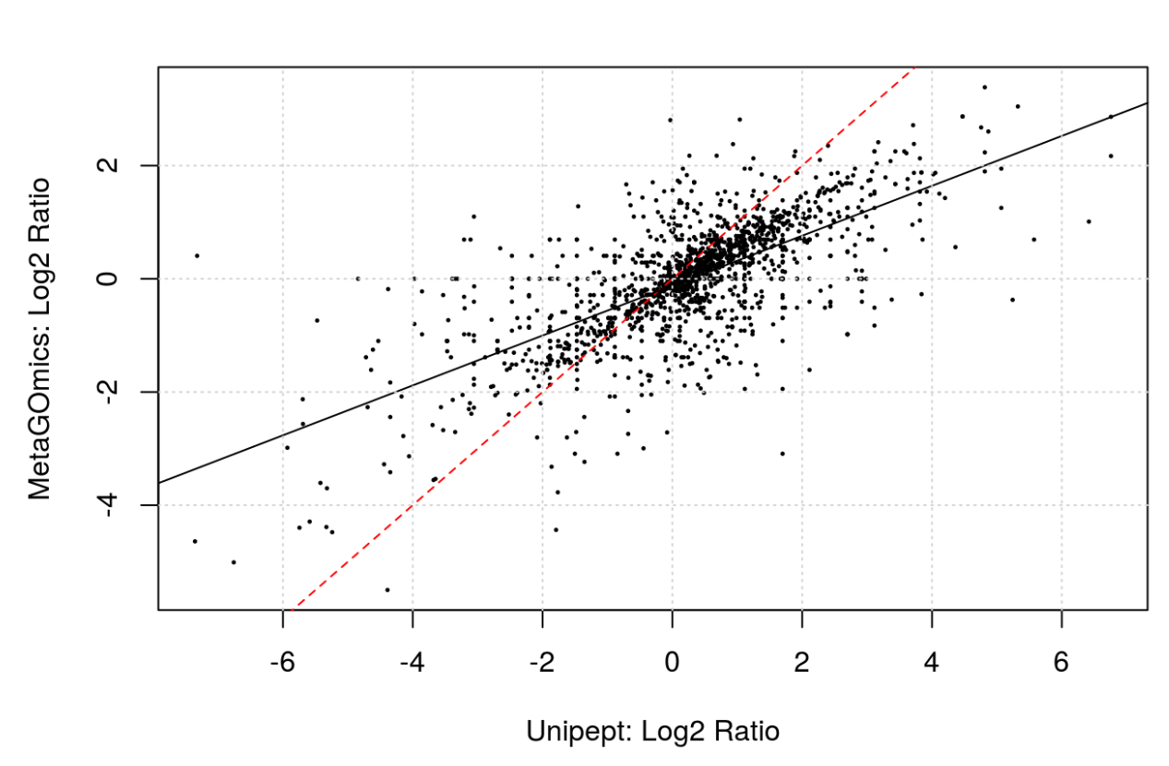
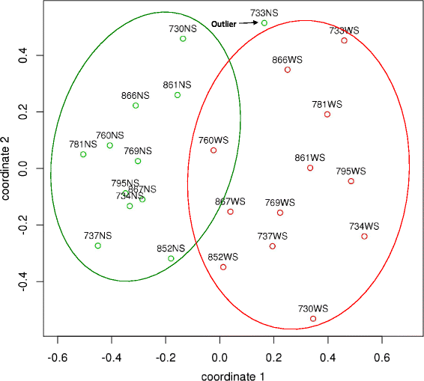
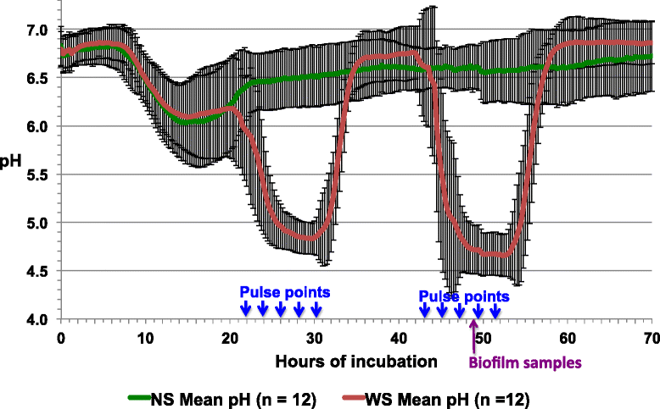
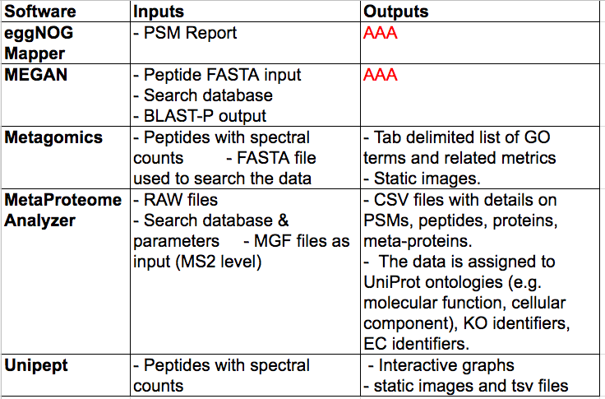
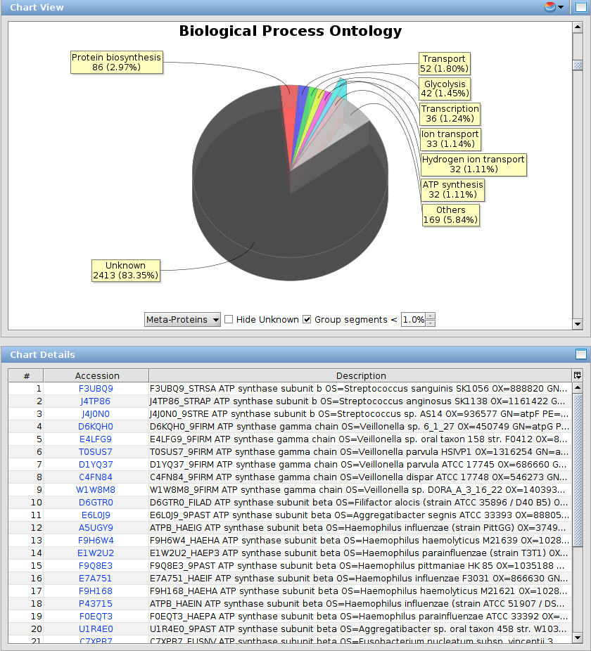

Unravelling The Functions of Microbiomes: A Comprehensive Evaluation of Sotware Tools for Functional Metaproteomics
Caleb Easterly¹; Carolin Kolmeder²; Thilo Muth³; Bart Mesuere⁴; Subina Mehta¹; Praveen Kumar¹; James Johnson¹, Shane Hubler¹ , Jaime Huerta-Cepas⁴, Bjoern Gruening; Michael Riffle; Damon May; W. Judson Hervey; Alessandro Tanca; Brook L Nunn; Joel Rudney; Timothy J. Griffin; Pratik D Jagtap
¹ Biochem. Mol Biol. Biophysics, University of Minnesota, Minneapolis, MN; ³ Advanced Clinical Biosystems Research Institute, Los Angeles, CA; ⁴ University of Freiburg, Freiburg, Germany;
⁵La Trobe University, Melbourne, Australia; ⁶Minnesota Supercomputing Institute, UMN, Minneapolis, MN; ⁷ Department of Biology, IMSB, ETH Zurich, Zurich, Switzerland; ⁸Faculty of Science, University of Zurich, Zurich, Switzerland
P1
INTRODUCTION
IDENTIFICATION STATISTICS and OVERLAP
FEATURES
Metaproteomics research involves large-scale characterization of the entire protein complement of the microbiome. Metaproteomics has potential to unravel the mechanistic details of microbial interactions with host / environment by analyzing the functional dynamics of the microbiome.
Many methods have been developed to determine the functional role of proteins expressed by the microbiome and subsequently shed light on its biological significance. The available software tools differ in emphasis, features, reproducibility, and other characteristics.
By using a previously published oral microbiome dataset, we explore the following qualitative and quantitative features of available functional analysis software tools: i) number of peptides that were mapped to functional groups and gene ontology terms; ii) different ontologies available within the tools; iii) ability to leverage quantitative information; iv) visualization of datasets; v) biological conclusions drawn from data, and vi) reproducibility, ease of use, and availability.
C2
 | EggNOG Mapper | MEGAN | MetaGOmics | MetaProteomeAnalyzer | UniPept
Level of Analysis | Functional annotation based on phylogeny based protein orthologs | Protein | Peptide | Meta-protein / protein groups | Peptide
Database for annotation | eggNOG Database | NCBI nr | NCBI nr + custom | UniProKB | UniProKB
Annotation Types | COG categories | Interpro2GO, eggNOG, SEED and KEGG | GO Terms | EC numbers, protein-level information from UniProt (ontology terms), NCBI, KEGG, KO groups | GO terms + EC numbers, Interpro
Comparative Analysis | Manual | Yes | Yes | Not in current version | not in current version
Usage | automated | interactive | automated | interactive + automated | automated
Taxonomy | best hit orthology includes NCBI tax id | Yes | Yes | Yes | Yes
Functional Analysis
https://docs.google.com/spreadsheets/d/1z9Rm9sgvScEUlB9D6YdA1wt2-ba7zcCo3inLGZFd3yY/edit?usp=sharing
Taxonomic Analysis
P2
SUMMARY
DATASET FOR FUNCTIONAL ANALYSIS
S1
OVEREXPRESSED PROTEIN LIST (TOP 5)
S2
USABILITY
Sucrose-induced dysbiosis in dental caries: Rudney et al., BMC Microbiome DOI: 10.1186/s40168-015-0136-z
- Mass spectral data was acquired from plaque samples from a patient at high risk for dental caries grown in biofilm reactor in the presence and absence of sucrose.
- Mass spectra were searched against the Human Oral Microbiome database (HOMD) to identify microbial peptides.
- Spectral counts were calculated to provide inputs for functional tools that were evaluated.
 | Spectral Counts | MS1 Quant Data
Single Sample | UniPept; MetaProteomeAnalyzer
Multiple Samples | MetaGOmics; MEGAN | eggNOG mapper
Previous functional analysis of the data had shown sucrose-induced changes in protein relative abundance patterns for several metabolic pathways which we compare with the conclusions drawn by each of the tools evaluated here.
TOOLS and METHODS USED FOR FUNCTIONAL ANALYSIS
VISUALIZATION
C1
C3
EggNOG Mapper | Downstream processing required
MEGAN | Heatmaps, PCoA plots, hierarchical cluster analysis, tree diagrams, rarefaction curves
MetaGOmics | Static images of hierarcheal clustering of GO terms.
MetaProteomeAnalyzer | - a click on a certain taxonomic level shows all different ontology terms (and assigned count data) and vice versa too. -Tables are interactive and the different hierarchical views are interlinked (selecting a certain taxonmic level updates all other views etc.). - Pie/barcharts also work for taxonomies. - Automated mapping of identified proteins to KEGG pathway in the webbrowser.
UniPept | treeview of EC numbers, sunburst of GO terms. Tables of frequencies of GO terms and taxa.
We compared several functional analysis tools on the basis of the following metrics:
Qualitative (refer to this spreadsheet)
different ontologies available within the tools ability to leverage quantitative information
visualization of datasets reproducibility, ease of use, and availability.
Quantitative
number of peptides that were mapped to functional groups and gene ontology terms
Overlap between GO terms for those that use them (eggNOG mapper, metaGOmics,
maybe more)
biological conclusions drawn from data
Overlap between OGs (MEGAN and eggNOG mapper)
Comparison of differentially expressed GO terms / other functional terms
For metaGOmics and Unipept, comparison of ratios for shared GO terms
Choose a few processes/terms and see how the fold changes compare across tools
Need some way to understand complicated metaproteomics data
How do we understand differences in processes that microbiome is carrying out?
- In single organism proteomics, would do differential expression
- This is difficult in metaproteomics due to exacerbated protein inference problem (peptides may be homologous to proteins from multiple organisms)
Several established functional analysis tools focus on single organisms (DAVID and the GO term enrichment service, for example).
Functional analysis tools offer a variety of ways of understanding the function of a microbiome
Peptide-centric
Protein-centric
Ontology-centric
GalaxyP is supported through the NSF Grant # and NCI…
MEgaN
METAGOMICS
METAPROTEOME ANALYZER
UNIPEPT

